Slide 1
References

Slide 2
Reading & Referencing
What were the quality and number of your references?
Did you use QUB Harvard / Harvard correctly?
See the below link and Cite them right
https://www.mendeley.com/guides/harvard-citation-guide
In-text citations
References – DOI
Bibliography – Only use if you have a mass of relevant reading that cannot be included in your text

Slide 3
Reading & Referencing
References
BBC News. (2020). What is Huawei and how could it be a security threat? [online] Available at: https://www.bbc.co.uk/news/newsbeat-47041341 [Accessed 19 Feb. 2020].
Theregister.co.uk. (2020). There are already Chinese components in your pocket – so why fret about 5G gear?. [online] Available at: https://www.theregister.co.uk/2020/01/30/engineering_an_end_to_5g_china_crisis/ [Accessed 19 Feb. 2020].
BT Intranet. (2020) Huawei Announcement [online]
Inside Out Security. (2020). 110 Must-Know Cybersecurity Statistics for 2020 | Varonis. [online] Available at: https://www.varonis.com/blog/cybersecurity-statistics/ [Accessed 19 Feb. 2020].
Hosting Tribunal. (2020). How Fast Is Technology Growing - Moore's Law Can't Keep Up. [online] Available at: https://hostingtribunal.com/blog/how-fast-is-technology-growing/ [Accessed 20 Feb. 2020].
Forbes.com. (2020). Huawei Security Scandal: Everything You Need to Know. [online] Available at: https://www.forbes.com/sites/kateoflahertyuk/2019/02/26/huawei-security-scandal-everything-you-need-to-know/#2654e59673a5 [Accessed 20 Feb. 2020].

Slide 4
Reading & Referencing: A Bad Example
Hayes, P., Ford, K., (1995), “Turing Test Considered Harmful”, 972-977
Moor, James H. “An Analysis of the Turing Test.” Philosophical Studies: An International Journal for Philosophy in the Analytic Tradition, vol. 30, no. 4, 1976, pp. 249–257. JSTOR, www.jstor.org/stable/4319091.
Hook, , L., Waters., R., Bradshaw, T., (2017) “Amazon pours resources into voice assistant Alexa”, Financial Times, Available at: https://search-proquest-com.uos.idm.oclc.org/docview/1868880360?accountid=17074&pq-origsite=summon
French, R, M., (2000), “The Turing Test: The first 50 years”, Trends in Cognitive science Volume 4 Issue 3” Available at: https://doi.org/10.1016/S1364-6613(00)01453-4 pp. 115-122
Nigram, S., (2019), “How Spotify know a lot about you using machine learning and AI”, Data science Central, Available at: https://www.datasciencecentral.com/profiles/blogs/how-spotify-know-a-lot-about-you-using-machine-learning-and-ai Accessed?
Schweizer, P., (1998), “The Totally True Turing Test”, Minds and Machines Volume 8, Available at: https://link-springer-com.uos.idm.oclc.org/article/10.1023%2FA%3A1008229619541 pp. 263-272

Slide 5
Reading & Referencing
Do not invent your own referencing style
Do not use footnotes
Look beyond mainstream media

Slide 6
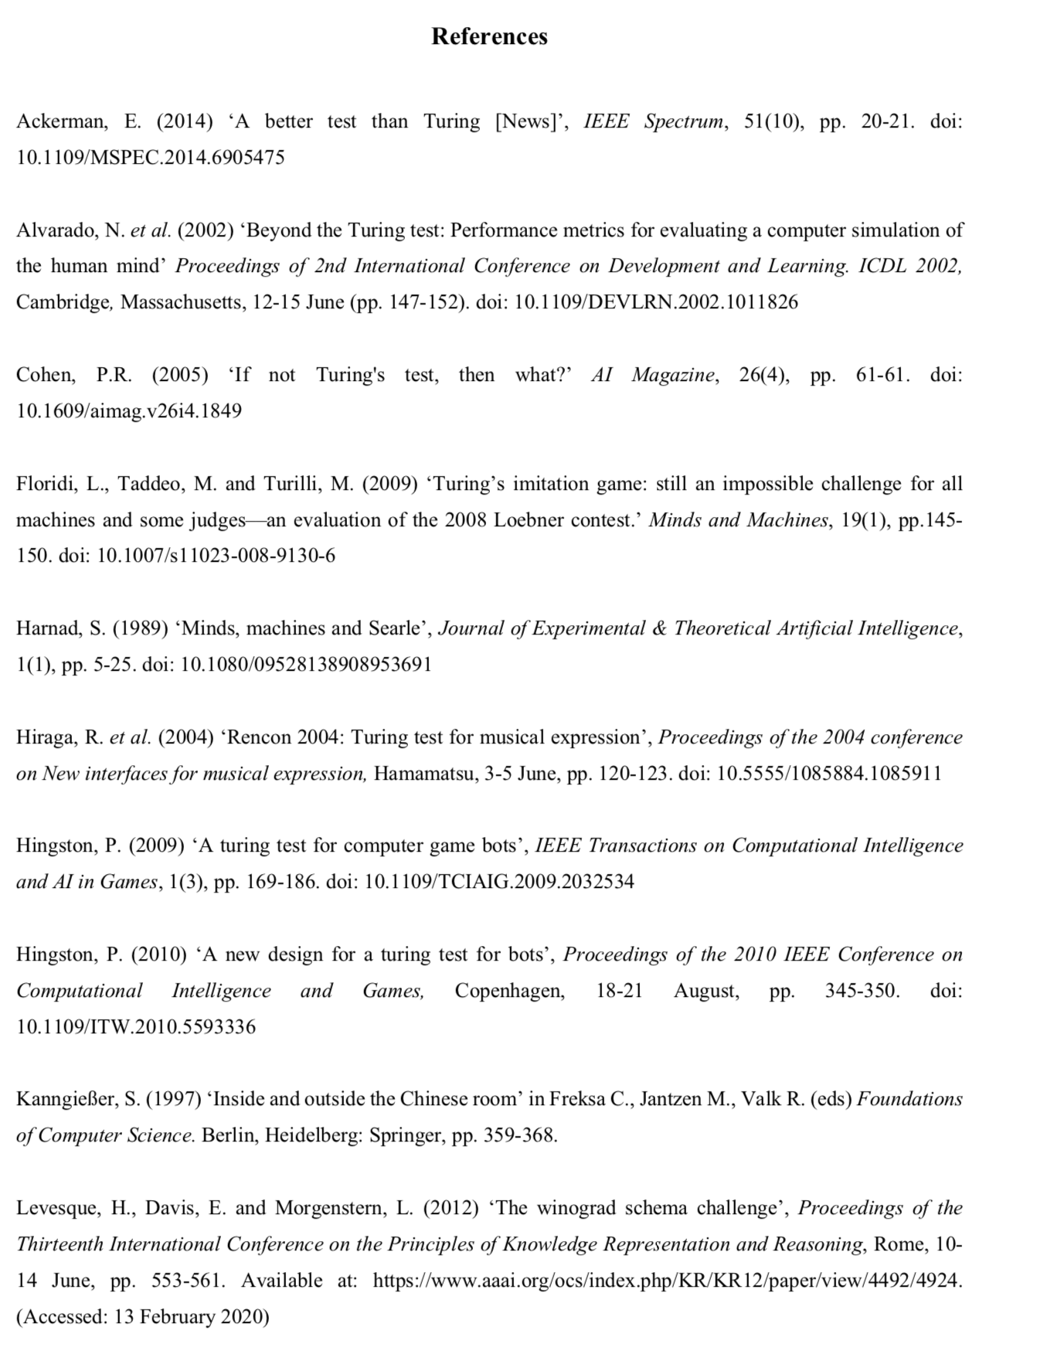
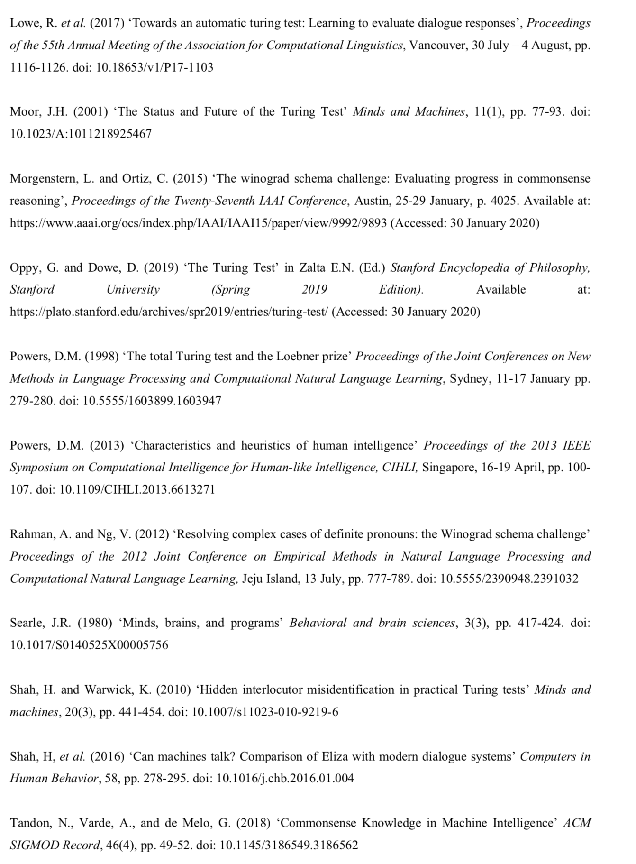
Reading & Referencing

Slide 7
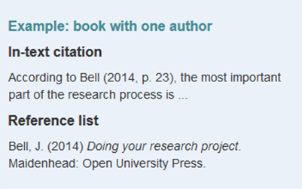

In-text Citation – Cite Them Right Books
Links
Citation order:
Author/editor
Year of publication (in round brackets)
Title (in italics)
Place of publication: Publisher
Series and volume number (where relevant)

Slide 8
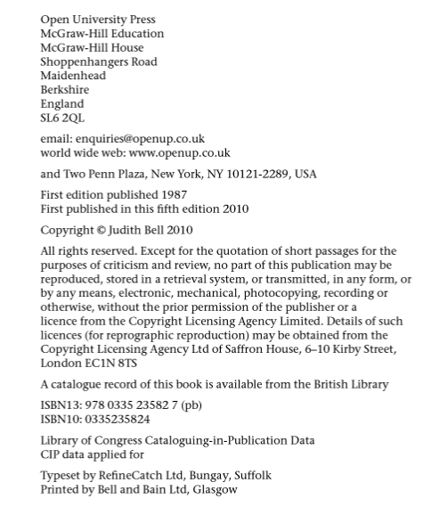

Book Example
Not the same edition

Slide 9
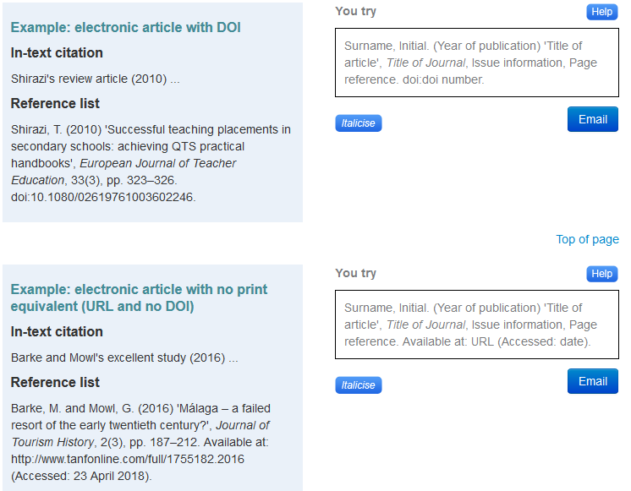
Journals
doi: Digital Object Identifier

Slide 10
Reference List Details
Citation order:
Author(s) (surname followed by initials)
Year of publication (in round brackets)
Title of article (in single quotation marks)
Title of journal (in italics – capitalise first letter of each word in title, except for linking words such as and, of, the, for)
Issue information (that is, volume (unbracketed) and, where applicable, part number, month or season (all in round brackets))
Page reference (if available)
If accessed online:
DOI or Available at: URL (if required) (Accessed: date)

Slide 11
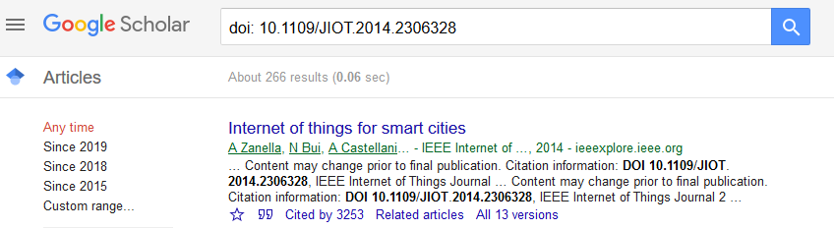
Journal - Example
Appeared 2nd item in reference list as follows:
Andrea Zanella, N. B. (2014, Febuary 14). ieeexplore.ieee.org/document/6740844. Retrieved from ieeexplore.ieee.org: http://ieeexplore.ieee.org/document/6740844/#full-text-section
Zanella, A., Bui, N., Castellani, A., Vangelista, L. and Zorzi, M. (2014). Internet of Things for Smart Cities, IEEE Internet of Things Journal, 1(1), pp. 22-32. doi: 10.1109/JIOT.2014.2306328

Slide 12
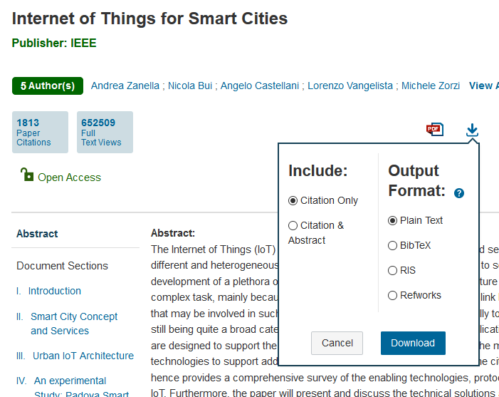
Journal - Example
Download Citation

Slide 13
Journal – Example Download Citation
A. Zanella, N. Bui, A. Castellani, L. Vangelista and M. Zorzi, "Internet of Things for Smart Cities," in IEEE Internet of Things Journal, vol. 1, no. 1, pp. 22-32, Feb. 2014.
doi: 10.1109/JIOT.2014.2306328
keywords: {Internet;Internet of Things;protocols;Padova smart city project;protocols;advanced communication technology;value-addedservices;Smart City vision;urban IoT system;link layer technology;digital services;heterogeneous end systems;Internet of Things;Urban areas;Smart buildings;Monitoring;Smart homes;Business;IEEE 802.15 Standards;Constrained Application Protocol (CoAP);Efficient XML Interchange (EXI);network architecture;sensor system integration;service functions and management;Smart Cities;testbed and trials;6lowPAN},
URL: http://ieeexplore.ieee.org/stamp/stamp.jsp?tp=&arnumber=6740844&isnumber=6810798

Slide 14
In-text Citation – Cite Them Right
Links

Slide 15
In-text Citation – Many ways to cite a source
Source
Despite the existence of pre-school education and the efforts that working parents put into finding the ‘best’ schools for their children, the family home has the greatest impact on educational development. This can clearly be seen when you look at the studies …
Child Development, Rogers and Green, 2008.
Author(s) + (date) + verb (e.g. argue, point out, state, assert)
Rogers and Green (2008) argue that ‘the family home has the greatest impact on educational development’.
Rephrasing the view
A child’s educational progress is most influenced by their home life (Rogers and Green 2008).

Slide 16
In-text Citation – Example 1
(Krämer, et al., 2013) Points out that ‘Internet neglects that Quality of Service (QoS) has always been an issue for the network of networks.’ However it is known this to be not be true since …..

Slide 17
In-text Citation – Example 1
(Krämer, et al., 2013) Points out that ‘Internet neglects that Quality of Service (QoS) has always been an issue for the network of networks.’ However it is known this to be not be true since …..
Krämer et. al., (2013) points out that ‘Internet neglects that Quality of Service (QoS) has always been an issue for the network of networks.’ However it is known this to be not be true since …..

Slide 18
In-text Citation – Example 2
According to the book Autonomous Driving: Technical, Legal and Social Aspects book (Barbara Lenz, Hermann Winner 2015 section 1 page 3) suggests that “The fully automated vehicle driven by itself without human supervision. Should system performance degrade, the vehicle is autonomously resorted to the system state of minimal risk.” ……

Slide 19
In-text Citation – Example 2
According to the book Autonomous Driving: Technical, Legal and Social Aspects book (Barbara Lenz, Hermann Winner 2015 section 1 page 3) suggests that “The fully automated vehicle driven by itself without human supervision. Should system performance degrade, the vehicle is autonomously resorted to the system state of minimal risk.” ……
Lenz and Winner (2015, page 3) suggest that “The fully automated vehicle driven by itself without human supervision. Should system performance degrade, the vehicle is autonomously resorted to the system state of minimal risk.” ……

Slide 20
In-text Citation – Example 3
Deborah Hersman speculates that consumer-wide access to autonomous vehicles is not as close as many perceive. In a Harvard gazette article Hersman (2018) said “We’re not going to have these in our garage as a consumer anytime soon.” …..

Slide 21
In-text Citation – Example 3
Deborah Hersman speculates that consumer-wide access to autonomous vehicles is not as close as many perceive. In a Harvard gazette article Hersman (2018) said “We’re not going to have these in our garage as a consumer anytime soon.” …..
Hersman (2018) speculates that consumer-wide access to autonomous vehicles is not as close as many perceive; “We’re not going to have these in our garage as a consumer anytime soon.” …..

Slide 22
In-text Citation – Example 4
Although social media has it perks with the way it’s been presented to us, it has come forward with issues. On sites such as Facebook you fill out information about yourself including information like your email address and other personal details following to your location. This could potentially dangerous as anyone is able to access this information and use it for their own needs, this puts you in a situation where someone else is copying your life. With social media you want to ensure that your safe with your information being stored on any site you have a profile with.

Slide 23
In-text Citation – Example 4
it has
Reword
Although social media has it perks with the way it’s been presented to us, it has come forward with issues. On sites such as Facebook you fill out information about yourself including information like your email address and other personal details following to your location. This could potentially dangerous as anyone is able to access this information and use it for their own needs, this puts you in a situation where someone else is copying your life. With social media you want to ensure that your safe with your information being stored on any site you have a profile with.
No supporting source
you are
Really?

Slide 24
Check the accuracy of in-text citations
Do not start a sentence with the author’s name and end the sentence with “(year, page).”
Either start with “Author (year, page) stated…” or end the sentence with ”… (Author, year, page).”
Make sure that you use original page numbers rather than the page number of any PDFs you have downloaded
Citations do not include the author’s first name or initials
Citations do not include the title of the book or article

Slide 25
Check the accuracy of references
Use https://www.mendeley.com/guides/harvard-citation-guide, to make sure that you can retrieve the document (and how to cite the document)
DOI references can just start with “DOI: 10.xxxx”
Consistently apply either QUB Harvard or Harvard
References do include the author’s initials
Use “References” if every source is cited
Use “Bibliography” if there are sources that are not cited

Slide 26
Check the quality of references
Having all your references from newspapers, magazines, blogs, dictionaries or Wikipedia (or other similar Wikis) does not suggest that you have engaged in a great deal of academic research
Some current technical topics may be biased towards this type of source, but do some digging and see what you can find

Slide 27
Remove unnecessary text
“Referring to the previous paragraph…”
”The previous paragraph highlights…”

Slide 28
Avoid rambling and run-ons
If you need to end a long paragraph with “In summary…” then it probably needs rewriting and shortening.
Avoid “and so on” and “etc.”

Slide 29
Avoid asking the reader questions
… what is … ?
… is it …?

Slide 30
Thank you ☺

